Slide 1
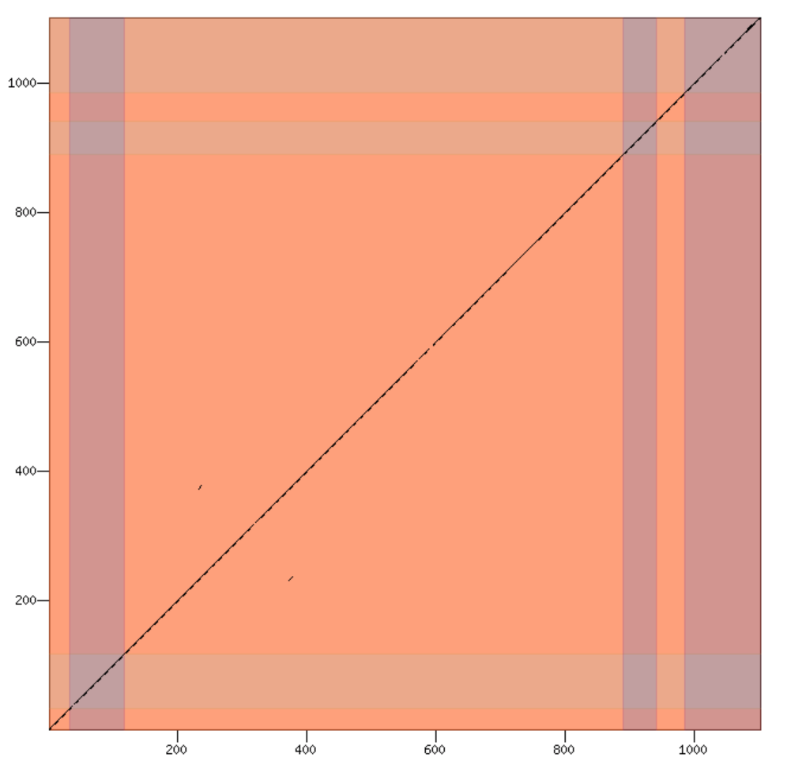
Tsc1-PA
6
5
4
D. yakuba peptide position
3
2
1
Exon Number
1
2
3
4
5
6
D. melanogaster peptide position

